Slide 1

FUNCTIONS

Slide 2
SESSION OVERVIEW:
TYPES & SYNTAX
SCOPE & LIFETIME
TYPES OF ARGUMENTS
RECURSION
LAMBDA FUNCTION

Slide 3
FUNCTION DEFINITION :
Function is a Group of Related statements that Performs a Specific Task
It helps to break our program into smaller & modular blocks.
It makes our Program more Organized & Manageable.
It Avoids Repetition & makes Code Reusable.
TYPES :
Build-in Functions
User Defined Functions

Slide 4
SYNTAX
Keyword def marks the start of the Function
Unique Function Name
Optional Parameters
Colon (:) to the End of the Function Heading
Indentation Level
Optional Return Statement
def <function name> (<parameter>) :
statements
return statement

Slide 5
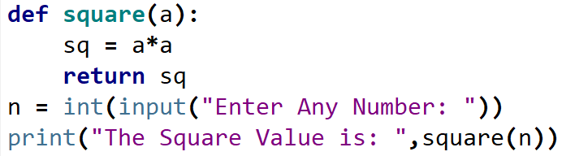


Slide 6
RETURN STATEMENT
The return statement causes your function to exit and returns a value to its caller.
The point of functions in general is to take inputs and return something.
This statement can contain expression which gets evaluated and the value is returned
If there is no expression in the statement or the return statement itself is not present inside a
function, then the function will return the None object.

Slide 7
SCOPE & LIFETIME
SCOPE : The part of the Program at which a Variable is accessible or Visible.
LIFETIME : the period throughout which the Variable Exist in Memory
TYPES :
Local Scope
Global Scope
Variable
Scope
Global
Scope
Local
Scope

Slide 8
A variable defined inside a function cannot be accessed outside it. Every variable has a well-defined accessibility.
The part of the program where a variable is accessible can be defined as the scope of that variable.
A variable can have one of the following two scopes:
A variable that has global scope is known as a global variable
a variable that has a local scope is known as a local variable.

Slide 9
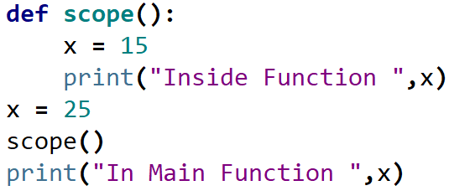


Slide 10
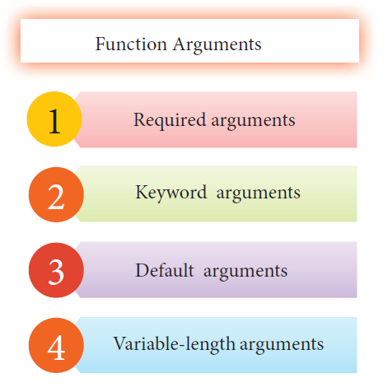

Slide 11
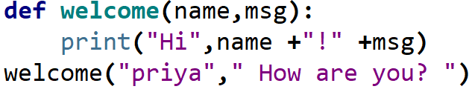


REQUIRED ARGUMENTS

Slide 12
REQUIRED ARGUMENTS
“Required Arguments” are the arguments passed to a function in correct positional order.
Here, the number of arguments in the function call should match exactly with the function definition.
You need at least one parameter to prevent syntax errors to get the required output.

Slide 13
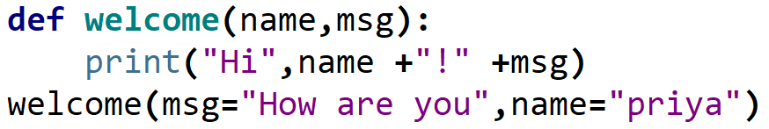

KEYWORD ARGUMENTS
Keyword arguments will invoke the function after the parameters are recognized by their parameter names.
The value of the keyword argument is matched with the parameter name and so,
one can also put arguments in improper order (not in order).

Slide 14
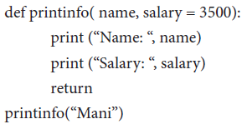


DEFAULT ARGUMENTS
In Python the default argument is an argument that takes a default value if no value is provided in the function call.
The following example uses default arguments, that prints default salary when no argument is passed.
When the above code is changed as printinfo(“Ram”,2000) it produces the following output:
In the above code, the value 2000 is passed to the argument salary, the default value already assigned for salary is simply ignored.

Slide 15

VARIABLE-LENGTH ARGUMENTS
In some instances you might need to pass more arguments than have already been specified.
Going back to the function to redefine it can be a tedious process.
Variable-Length arguments can be used instead.
These are not specified in the function’s definition and an asterisk (*) is used to define such arguments.
Lets see what happens when we pass more than 3 arguments in the sum() function.

Slide 16
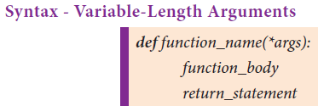
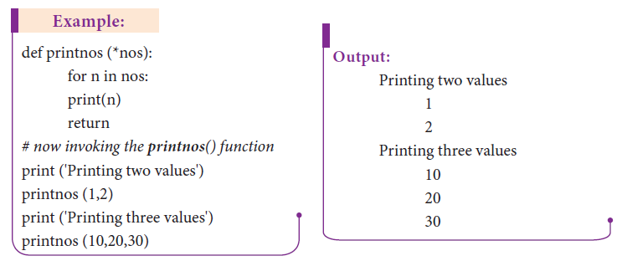
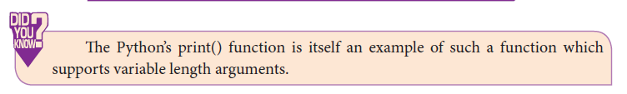

Slide 17
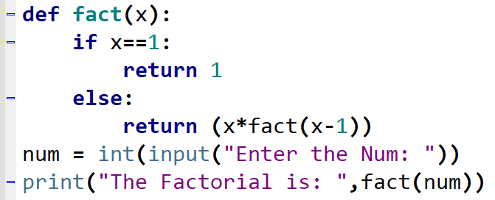

RECURSION
A Function Which Calls Itself Is Called Recursive Function

Slide 18
ADVANTAGES
DIS-ADVANTAGES
It make the Code to Look Clean & Easy to Write
A Complex Problem can be Broken down into simpler block of code
Sequence Generation is Easier with Recursion than using some Nested Iteration
The Logic Behind Recursion is Hard to Understand unless Explained
Recursive Calls occupies a lot a Memory & Time
It is Hard to find the Errors & Debug

Slide 19
LAMBDA FUNCTION
Lambda Function or Anonymous Function
It is a Function that is defined Without a Name
While Normal Functions are Defined using the def keyword.
In Python, Anonymous Functions are defined using the lambda Keyword
SYNTAX :
Lambda arguments : expression

Slide 20
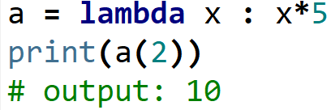
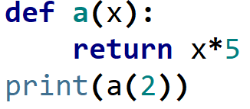
Lambda Functions can have any number of Arguments but only one Expression. The Expression is Evaluated & Returned
a -> Function Name
lambda , def -> Keywords
x -> Arguments
x*5 -> Expressions
print(a(2)) -> Function call

Slide 21
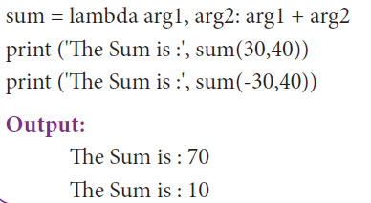
Function Name ->
Keywords ->
Arguments ->
Expressions ->
Function call ->

Slide 22
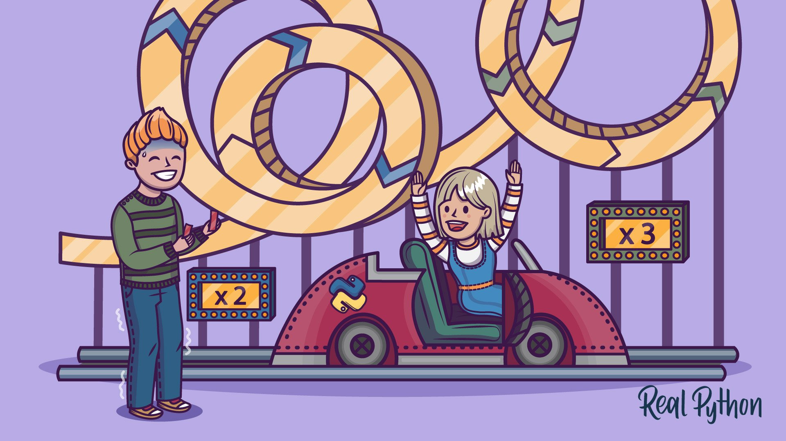
CODING IS FUN ! THANK YOU !!

